Slide 1
PROJECT
WATER LEVEL INDICATOR
By:
M HARIHARAN 22BEC1126
UDIT KRISHNA 22BEC1080
K L KRISHNA CHAITANYA REDDY 22BEC1215

Slide 2
INTRODUCTION
The water level indicator is defined as a system which gets the information about the water level in reservoirs or in tanks which is used in homes. By using the water level indicator we can overcome the overflow of water from the tankers.

Slide 3
COMPONENTS REQUIRED:
IC 7404
BC 547 TRANSISTOR
RESISTOR – 10K OHM, 220 OHM
BREADBOARD
WIRES
LED
11.1V BATTERY
7805 MOSFET
NOT GATE
SOFTWARE USED:
MULTISIM

Slide 4
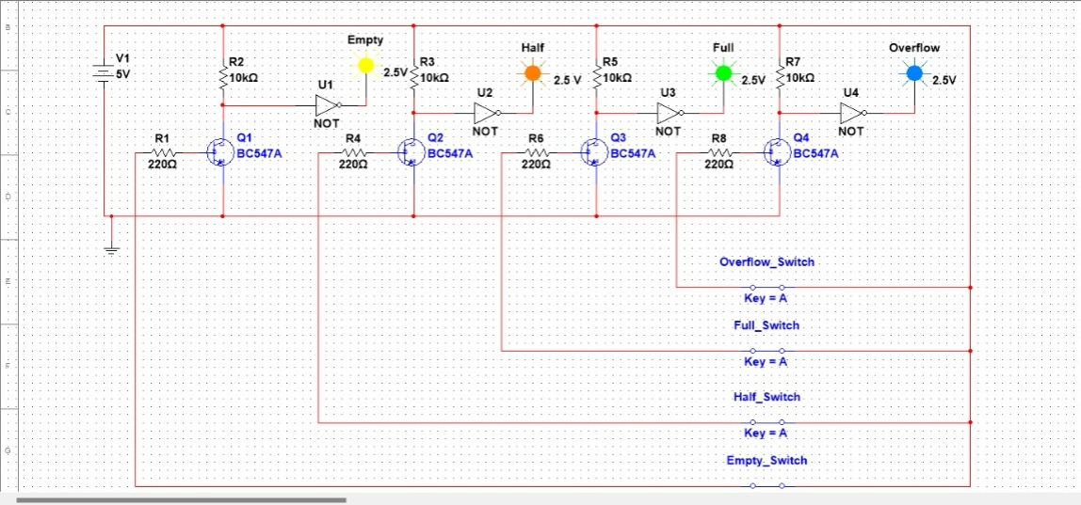
CIRCUIT:

Slide 5
WORKING:
The operation of this project is very simple and can be understood
easily. In our project “water level indicator” there are 3 main
conditions:
There is no water available in the tank i.e.empty
Intermediate level i.e. either half or full
There is more of water available in the tank than required i.e.overflow
So let us discuss more about these 3 conditions

Slide 6
Condition 1:
Water is not available in the tank
By looking at the circuit we can get to know about the connections. Coming to the first condition where the tank is empty when the base transistor connection wire(Q1) and the 5V connection wire is dipped in the water it gets short circuited and transistor(Q1) gets open circuited and there is voltage gets dropped in the 10k ohm resistor(R2) and at the collector point there is 0 voltage which acts as a input for the NOT(U1) gate and gives output 1 where the LED light glows yellow which indicates that the tank is empty.

Slide 7
CONDITION 2:
WATER IS HALF OR FULL IN THE TANK
Coming to the second condition where the water is half or full in the tank. Lets first see what happens when there is half water in the tank. When the base transistor connection wire(Q2) is dipped in water along with base transistor connection wire (Q1) and 5V connection wire because only after these connections are dipped, water can touch transistor base connection wire(Q2).So when all the three wires are dipped in water they get short cirucuited Q2 transistor becomes open and there is voltage drop across 10k ohm and there is 0 voltage at collector connection wire which is the input for the NOT gate which gives 1 as output and the LED glows in the colour of orange which indicates that the water in the tank is half.This is the same process when the water in the tank is full where the LED light glows in green colour.

Slide 8
CONDITION 3:
WATER IS OVERFLOWING IN THE TANK
Coming to the third and final condition where the water in the tank is overflowing. So when there is an overflow in the tank it means that all the all base transistor wires (Q1,Q2,Q3) and 5V are dipped in the water as it an overflow condition and even base transistor wire (Q4) is also dipped in the water and which makes the transistor Q4 open and there is voltage drop across 10k ohm resistor and there is 0 voltage at the collector point which is the input for the NOT gate and gives output 1 where the LED light glows in blue colour which indicates that there is overflow of water in the tank.

Slide 9
RESULTS AND DISCUSSIONS
Coming to the results and discussion,we have successfully the device(water level indicator ) that can accurately measure the water level in bottle .The device is easy to install and operate and it is relatively inexpensive and the project is very simple and highly efficient in conserving water. The device was able to accurately measure the water level in the bottle. This project also has various applications such as Domestic water conservation,Industrial water management,Agricultural irrigation,Environmental monitoring.As the technology continues to develop, water level indicators are likely to become affordable and widely used. So this project is really helpful in conserving water.It should be marketed to wider audience,should made more affordable also this project should developed to make it more accurate and versatile.It should be installed in all homes for knowing the amount of water that has been consumed and minimize the usage of water just for the needs and not to use excess of water and the government should take initiatives to make this device widely available to people. I hope this project has the potential to make a significant impact on water level conservation efforts around the world.

Slide 10
THANK YOU

